Slide 1
Major Project Phase –II (A4445) Domain: Signal Processing & Image Processing
VARDHAMAN COLLEGE OF ENGINEERING, HYDERABAD
Autonomous institute, affiliated to JNTUH
Team No. – S & IP : 07
Augmented Entites in real world for E-learning
By
18881A04A4– Rapolu Ravi Teja
18881A0491– M.Krishna Gopal
Under the guidance of
Dr. G. A. E. Sathish Kumar
Head & Professor, Dept. of ECE

Slide 2
Augmented Entites in real world for E-learning
Outline:
Objectives
Motivation
Introduction
Literature Survey
Proposed Design (Block diagram and/or Flow chart)
Results and Discussion (if project completed)
Conclusion (if project completed)
References

Slide 3
Augmented Entites in real world for E-learning
Objectives:
Our Objective is to build a learning platform for students which can transform two-dimensional teaching methods into immersive three-dimensional experiences along with the desired three dimensional objects.
Relieve teachers from carrying expensive specimen or sometimes dangerous specimen to carry into the classroom ad still get all the benifits

Slide 4

Augmented Entites in real world for E-learning
Motivation:
Classrooms that lack visual elements that help students to understand better a picture is better than telling a thousand words.
Augmented reality is the technology that can transform learning completely.

Slide 5
Augmented Entites in real world for E-learning
Introduction:
Augmented Reality (AR) is a groundbreaking technology which enhances the real world by virtual objects in order to create a new mixed reality environment.
One of the key challenges for Augmented Reality applications is the tracking of the user’s viewing position and orientation in real-time, in order to obtain precise alignment between real and virtual objects
For example: Information collected from web, have to cite below mentioned
Source: Ryan Jacoby and Diego Rodriguez, Innovation, Growth, and Getting to Where You Want to Go, Design Management Review Vol. 18 No. 1

Slide 6
Augmented Entites in real world for E-learning
Literature Survey: 01
HE Learning System Using Augmented Reality [1]
Methodology : Augmented models are displayed to students in the desktop PC . Simple geometrical objects can be subjected to scaling rotating ..etc[1]
Advantage: The user has a full understanding of the geometrical shapes that he placed and scaled in his own scene
Drawbacks: It is limited and requires special software called Unity to be installed on the system.

Slide 7
Augmented Entites in real world for E-learning
Literature Survey: 02
Head-Mounted Displays A Head-Mounted-Display (HMD) I E-learning
Methodology : Augmented models are displayed to students via a head mounted device. So that it is immersive in real world[2]
Advantage: The wearer has a very intuitive and 360 degree overview of the model in his current scene
Drawbacks The head mounted device is an extra device needed and comprises of extra hardware cost along with software cost.

Slide 8
Augmented Entites in real world for E-learning
Literature Survey: 03
AUGMENTED REALITY IN E-LEARNING SYSTEM
Methodology : The main concept behind this project is to collate educational content with information technology. This helps students to understand the 3D objects in a better [3]
Advantage: The user has a UI and He can use the UI to view the 3D model I the space and view it I different angles
Drawbacks: Comprises of Complex and resource heavy software like Unity and Vuforia. And limited to PC only.

Slide 9
Augmented Entites in real world for E-learning
Literature Survey: 04
Applying Object Recognition and Tracking to Augmented Reality for Information Visualization
Methodology : Bayesian Technique for overlaying objects on the video input[4]
Advantage: bringing virtual objects into video frames.
Drawbacks: only works on PC and is a special software to be installed by the user.

Slide 10
Augmented Entites in real world for E-learning
Literature Survey: 04
Applying Object Recognition and Tracking to Augmented Reality for Information Visualization
Methodology : Bayesian Technique for overlaying objects on the video input[4]
Advantage: bringing virtual objects into video frames.
Drawbacks: only works on PC and is a special software to be installed by the user.

Slide 11
The Project uses and homography algotithms to track the image and reduce the resources and uses Web XR API so that it can work on any device that support AR and has a camera and a web browser.

Slide 12
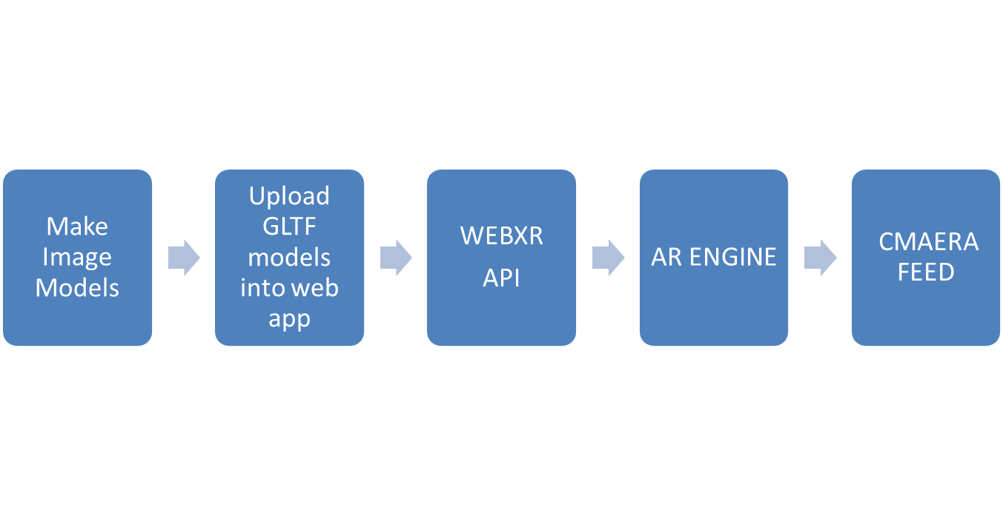
Augmented Entites in real world for E-learning
Block Diagram or Flow Diagram

Slide 13
Augmented Entites in real world for E-learning
Project Description
We are building a system for students that can help teachers to better explain concepts and use modern Augmented reality technology and create GLTF models using #D modeling software like Blender.
GLTF stands for Graphics Language Transmission Format which is portable and creatable and can hold 3D model data in a very efficient way.
We are using WEBXR API where XR stands for Extended reality which include AR and VR for the web

Slide 14
Augmented Entites in real world for E-learning
Project Description
Inside the AR Engine block is a Projection/ Trajectory detection Function.
Using Homography technique
In Homography the image vector that has same features as the uploaded marker it is being uploaded will be compares to see the marker really exist In the scene and renders the gltf model.
Video Image
Projection
function
Movement of the model in the feed

Slide 15
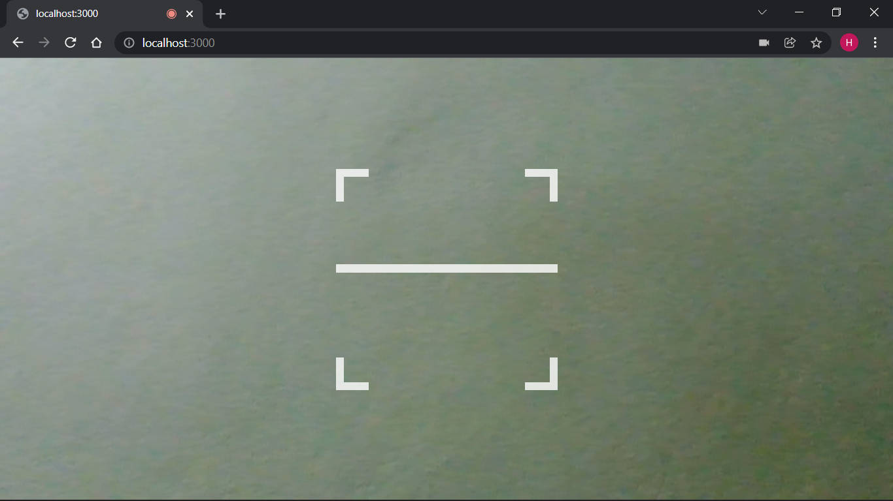
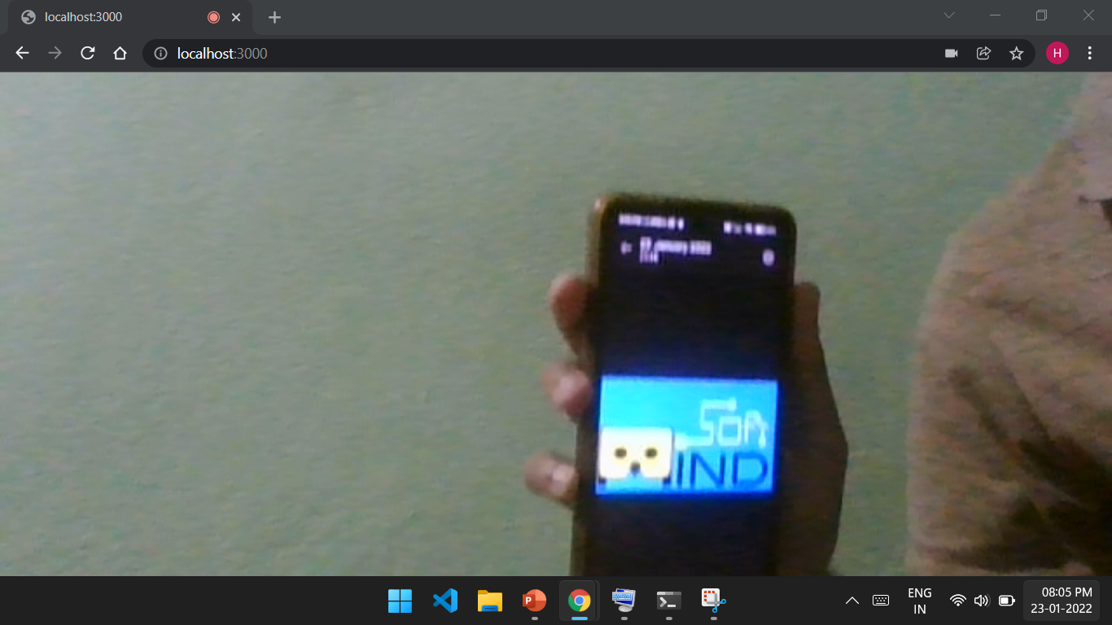
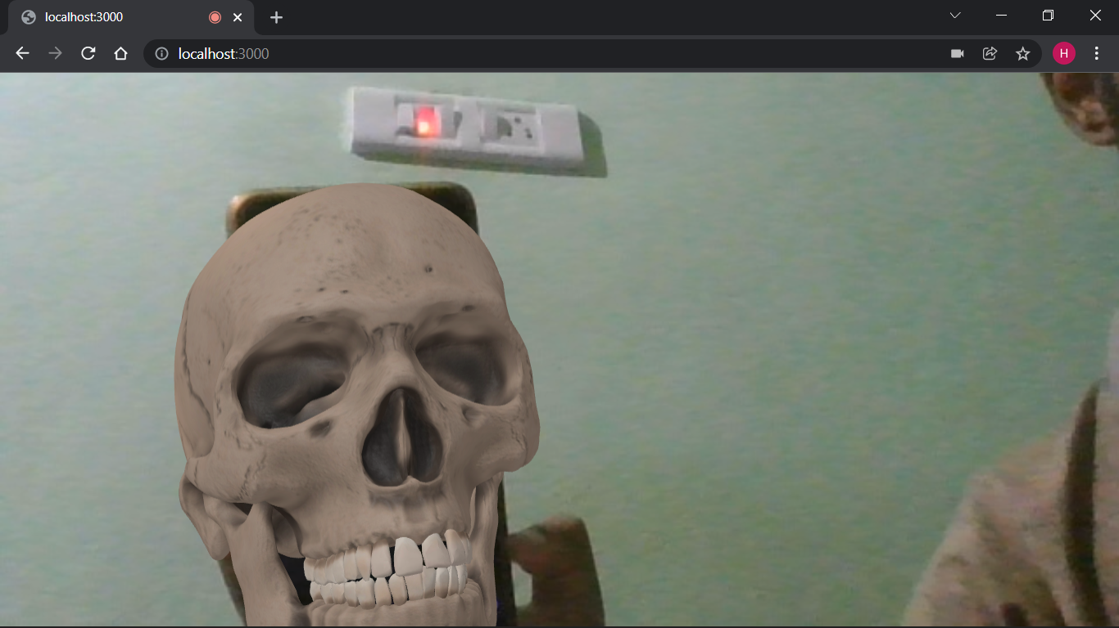
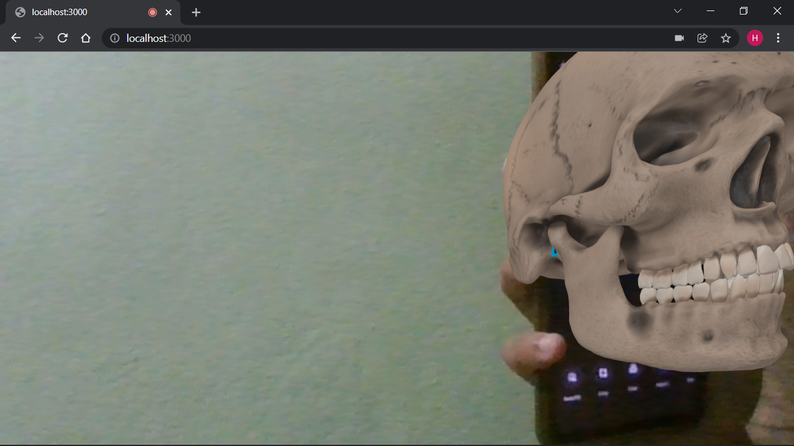
Augmented Entites in real world for E-learning
Results

Slide 16
Augmented Entites in real world for E-learning
Conclusion
The Ultimate goal is to reach as may devices supported as possible with less resource usage ad o external software requirements. i.e, as a web platform
Using YOLO (You only Look Once) algorithm is efficient and faster compared to other algorithms and as the algorithm does ot process a frame twice. There is a huge performance boost.

Slide 17
Augmented Entites in real world for E-learning
References
S. Patil, C. Prabhu, O. Neogi, A. R. Joshi and N. Katre, "E-learning system using Augmented Reality," 2016 International Conference on Computing Communication Control and automation (ICCUBEA), 2016, pp. 1-5, doi: 10.1109/ICCUBEA.2016.7860038.
Dutta, Kamalika. (2019). Augmented Reality for E-Learning.
S.Selvakumara Samy , Vikash Kumar , Rishabh Raj Singh,International Journal of Pure and Applied Mathematics Volume 118 No. 20 2018, 291-296
Silva, Rodrigo & Rodrigues, Paulo & Mazala, Diego & Giraldi, Gilson. (2019). Applying Object Recognition and Tracking to Augmented Reality for Information Visualization.

Slide 18
Augmented Entites in real world for E-learning
Thank You !!!

